Slide 1
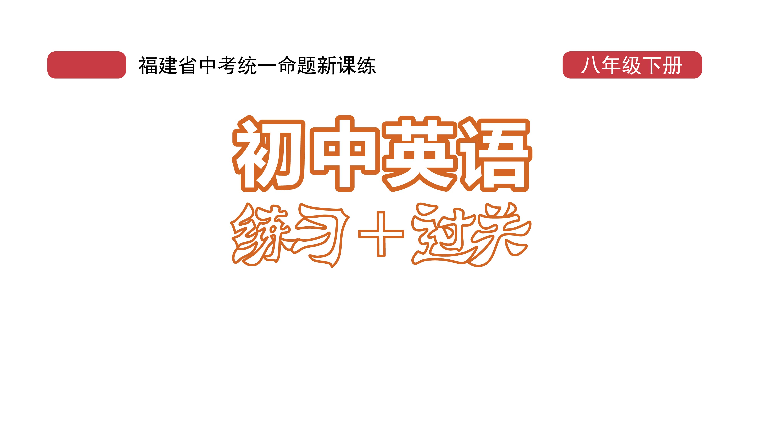
课时练习
模块六 第二章 第三节

Slide 2
一、翻译下列词组。
1. 充满…… ____________________________
2. 对……感到惊奇 ______________________
3. 拿出 ________________________________
4. 四面八方 ____________________________
5. 踩到某人的脚 ________________________
6. 挤出去 ______________________________
be full of/be filled with …
be surprised at …
take out
in all directions
step on one’s feet
push one’s way out

Slide 3
一、翻译下列词组。
7. 一……就…… _____________________________
8. 旅游经历 _________________________________
9. 情不自禁做某事 ___________________________
10. 进行两天的旅行 __________________________
11. 在中国西南部 _____________________________/
______________________________
as soon as
travel experiences
can’t help doing sth.
have a two-day trip
in the southwest of China
in the southwestern part of China

Slide 4
二、用括号内所给单词的适当形式填空， 每空一词。
1. The Chunxi Road in Chengdu is always _________ (crowd) and noisy.
2. This won’t solve the problem but it’s a step in the right _________ (direct).
3. Doctors were ________ (worry) about the spread of COVID-19 variants(变异毒株).
crowded
direction
worried

Slide 5
二、用括号内所给单词的适当形式填空， 每空一词。
4. Jack turned around quickly and ________ (step) on the man’s feet.
5. Those pandas were so cute that we couldn’t help ________ (take) photos of them.
stepped
taking

Slide 6
三、情景交际。
1. 终于找到走散多时的同伴时，你会这样说：
There _____________________!
2. 你想提议朋友一起骑车去公园，可以这样说：
How about ____________________________________?
you are
riding bicycles/bikes to the park together

Slide 7
三、情景交际。
3. 这条东西向的河长一公里，你可以这样告诉对方：
___________________________________________
___________________________________________.
The river is 1,000 meters/a kilometer long from east to west

Slide 8
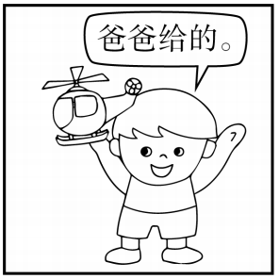
四、看图写话。
1. receive
The boy/He received a model plane from his father.

Slide 9
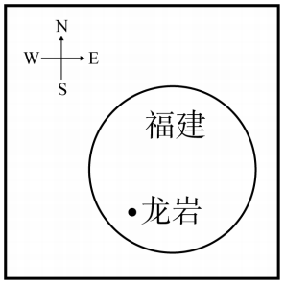
四、看图写话。
2. be
Longyan is in the southwest of Fujian Province.

Slide 10
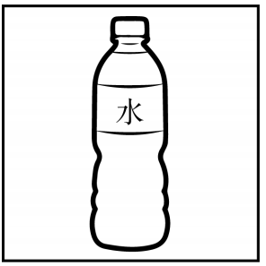
四、看图写话。
3. be full of
The bottle is full of water.

Slide 11
五、熟词生义。
1. raise A. vt. 提高 B. vt. 筹集；集资
C. vt. 饲养；抚养 D. vt. 提出
_____ (1) Please raise your voice to make yourself heard.
_____ (2) The mother raised four kids virtually(几乎) single-handedly.
_____ (3) The man raised money to build a school in the poor area.
A
C
B

Slide 12
五、熟词生义。
_____ (4) Finally we answered the question that was raised at the meeting.
D

Slide 13
五、熟词生义。
2. announce A. vt. 宣布，宣告 B. vt. 显示；意味着
C. vt. & vi. (尤指通过广播)通知
____ (1) Warm sunshine announces the coming of spring.
____ (2) They announced their engagement(订婚).
____ (3) The station announced that the train would be delayed(延误).
B
A
C

Slide 14


